Slide 1
DATA MINING-CS6001 SPATIAL DATA MINING
Name: Ananda Balagi S
Regno: 2021503502

Slide 2
What is Spatial Data Mining?
Spatial data mining is a specialized subfield of data mining that deals with extracting knowledge from spatial data. Spatial data refers to data that is associated with a particular location or geography.
Examples of spatial data include maps, satellite images, GPS data, and other geospatial information.
Spatial data mining involves analyzing and discovering patterns, relationships, and trends in this data to gain insights and make informed decisions.

Slide 3
Why Spatial Data Mining is Required?
The use of spatial data mining has become increasingly important in various fields, such as logistics, environmental science, urban planning, transportation, and public health.
For instance, a transportation company can optimize its delivery routes for faster and more efficient deliveries using spatial data mining techniques.
They can analyze their delivery data along with other spatial data, such as traffic flow, road network, and weather patterns, to identify the most efficient routes for each delivery.

Slide 4
Types of Spatial Data
Point Data
Point data represents a single location or a set of locations on a map. Each point is defined by its x and y coordinates, representing its position in the geographic space. Point data is commonly used to represent geographic features such as cities, landmarks, or specific locations of Interest. Examples of point data in transportation include delivery locations, bus stops, or railway stations.
Line Data
Line data represents a linear feature, such as a road, a river, or a pipeline, on a map. Each line is defined by a set of vertices, which represent the start and end points of the line. Line data is commonly used to represent `transportation networks, such as roads, highways, or railways. Line data is also used in other areas, such as hydrology, geology, or ecology, to represent streams, faults, or animal migration routes.

Slide 5
Types of Spatial Data
Polygon Data
Polygon data represents a closed shape or an area on a map. Each polygon is defined by a set of vertices that connect to form a closed boundary. Polygon data is commonly used to represent administrative boundaries, land use, or demographic data. In transportation, polygon data can be used to represent areas of interest, such as delivery zones or traffic zones.
Raster Data
The Raster Data refers to space in the form of a grid of pixels, where each cell of the grid represents some attributes. It is used to represent the phenomena like satellite imagery, remote sensing, etc.
Image Data
Image Data, as the name suggests, consists of spatial data in the form of images. It is most often used for object detection, capturing visual information about Earth, land cover classification, etc.

Slide 6
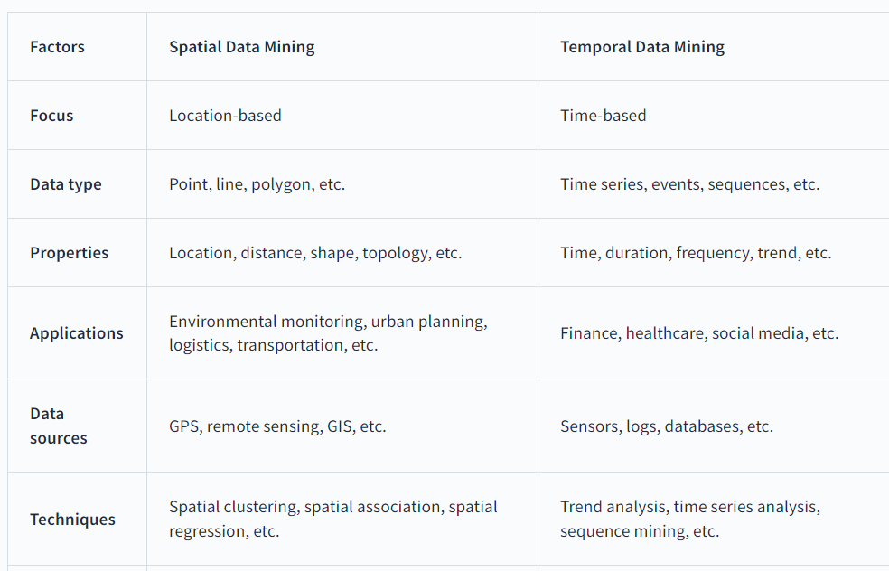
DIFFERENCE BETWEEN SPATIAL AND TEMPORAL DATA MINING

Slide 7
Applications of Spatial Data Mining
Urban Planning: Spatial Data Mining informs decisions on urban growth, transportation, and land use planning, enhancing urban dynamics.
Public Health: Spatial Data Mining identifies disease patterns, tracks infections, and optimizes healthcare resource allocation, aiding public health research.
Transportation: Spatial Data Mining identifies traffic patterns, manages transportation networks, and optimizes routes, improving efficiency.
Environmental Management: Spatial Data Mining detects environmental changes, conserves resources, and monitors biodiversity, supporting sustainable management.
Crime Analysis: Spatial Data Mining identifies crime hotspots, analyzes patterns, and informs prevention strategies, enhancing public safety.

Slide 8
THANK YOU

